Slide 1
Tempo Extraction using Beat Histograms
George Tzanetakis
University of Victoria
Computer Science Department (also in Music)
Presenter: Mao-Yuan Kao
Date: Aug. 24, 2006

Slide 2
Approach
Algorithms that use self-similarity at either single or multiple
bands
the signal is separated into different frequency bands
using a Discrete Wavelet Transform (DWT).
Essentially each bands corresponds to the energy
in an octave.
The envelope of each band is calculated using
Full Wave Rectification, Low Pass Filtering and
Normalization.

Slide 3
Approach (cont.)
The purpose of the envelope extraction step is to retain
events in that particular octave without being affected
by particular pitches.
The normalized envelopes are added with the effect of
enhancing common periodicities with the same phase.

Slide 4
Approach (cont.)
The sum of the normalized envelopes is then processed
through an autocorrelation function to detect the
dominant periodicities of the signal

Slide 5
Autocorrelation
Autocorrelation is a mathematical tool used frequently
in signal processing for analysing functions or series of
values, such as time domain signals.
It is the cross-correlation of a signal with itself.
Autocorrelation is useful for finding repeating patterns
in a signal, such as determining the presence of a
periodic signal which has been buried under noise, or
identifying the fundamental frequency of a signal which
doesn't actually contain that frequency component, but
implies it with many harmonic frequencies.

Slide 6
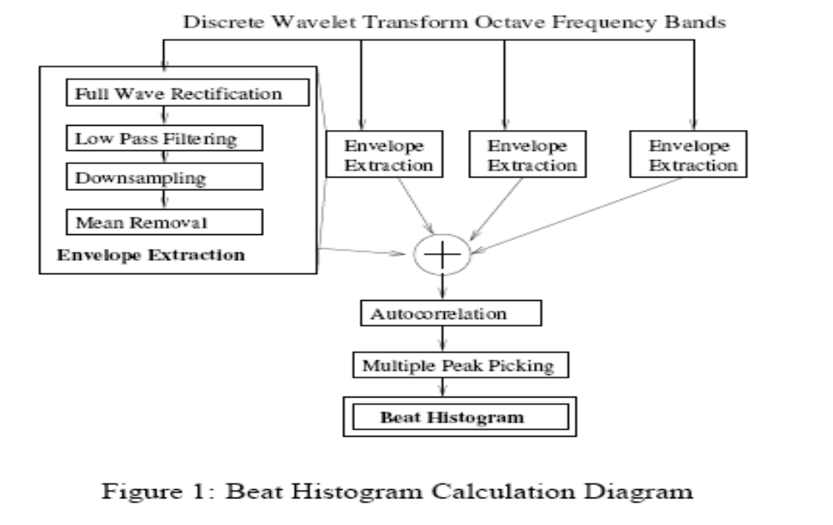

Slide 7
Downsampling
Downsampling is the process of reducing the sampling rate of a signal. This is usually done to reduce the data rate or the size of the data.
For example, if compact disc audio is downsampled by a factor of 5/4 then the resulting sampling rate goes from 44,100 Hz to 35,280 Hz, which reduces the bit rate from 1,411,200 bit/s to 1,128,960 bit/s.

Slide 8
Mean Removal
Mean removal is another one of those concepts -- like differential coding –
What is a mean? It’s an average. It’s the sum of n items divided by n. Not difficult. Removal in this context is just mathematical subtraction. To remove a mean from, say, a vector of numbers, sum the numbers, divide the sum by the number of elements in the vector, and subtract that number from each element in the vector

Slide 9
Example
17 24 18 16
11 25 20 17
12 20 22 19
15 19 23 21 Sum / 16 = 299 / 16 = 18
For the mean removal part, subtract the mean of 18 from each element in the vector:
-1 6 0 -2
-7 7 2 -1
-6 2 4 1
-3 1 5 3

Slide 10
Peak-Picking Algorithm
Correct minor pitch estimation errors
Alleviate non-integer pitch effects
Initialize harmonics zones
Look for local maxima in a search interval that excludes neighboring harmonics
http://www.ece.ucsb.edu/scl/demo/Liang/phcc/sld010.htm
http://physchem.ox.ac.uk/~jwong/specalign/docu/hid_spectrum_pickpeaks.htm

Slide 11
The Beat Histogram (BH) shows the distribution
of various beat periodicities of the signal.
For example a piece with tempo 60 Beats-per-Minute
(BPM) would probably exhibit BH peaks at 60 and 120
BPM (quarter and eight notes respectively).

Slide 12
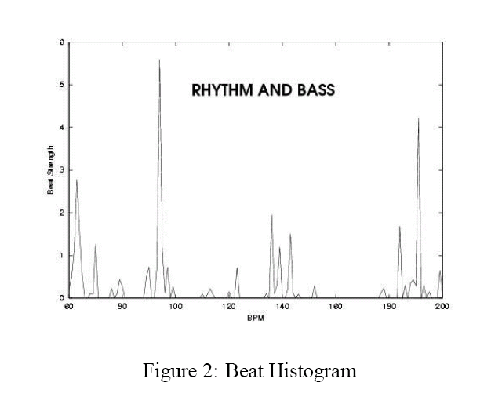
Figure 2 shows the BH for a HipHop piece (notice
the peaks at 96 BPM (main tempo) and 192 BPM).

Slide 13
The two main peaks of the BH are selected as the two
dominant tempos.
The histogram is constructed by adding the
autocorrelation values for each particular periodicity
therefore the height of the peaks correpond to the
“strength” of that particular beat and is used to calculate
the relative strength of each tempo.
Peak picking in the subband envelopes is used to
Calculate the phase of each tempo.

